Slide 1
Raw binary data
(36 Bit)
100000001000000100100110111101011110
binary data
(40 Bit)
10000000 10000001 00100110 11110101 11100000
Byte 0
Byte 1
Byte 2
Byte 3
Byte 4
Decoding
10000000 10000001 00100110 11110101 11100000
Sensor ID
0x80
Constant Pattern
0xf
94 (Humidity × 1)
Humidity = 94 %
ok
Battery Indicator
(1=Battery ok)
+294 (signed rawTemp × 10)
Channel
0
Temperature = +29.4 °C
created by Henry Thasler

Slide 2
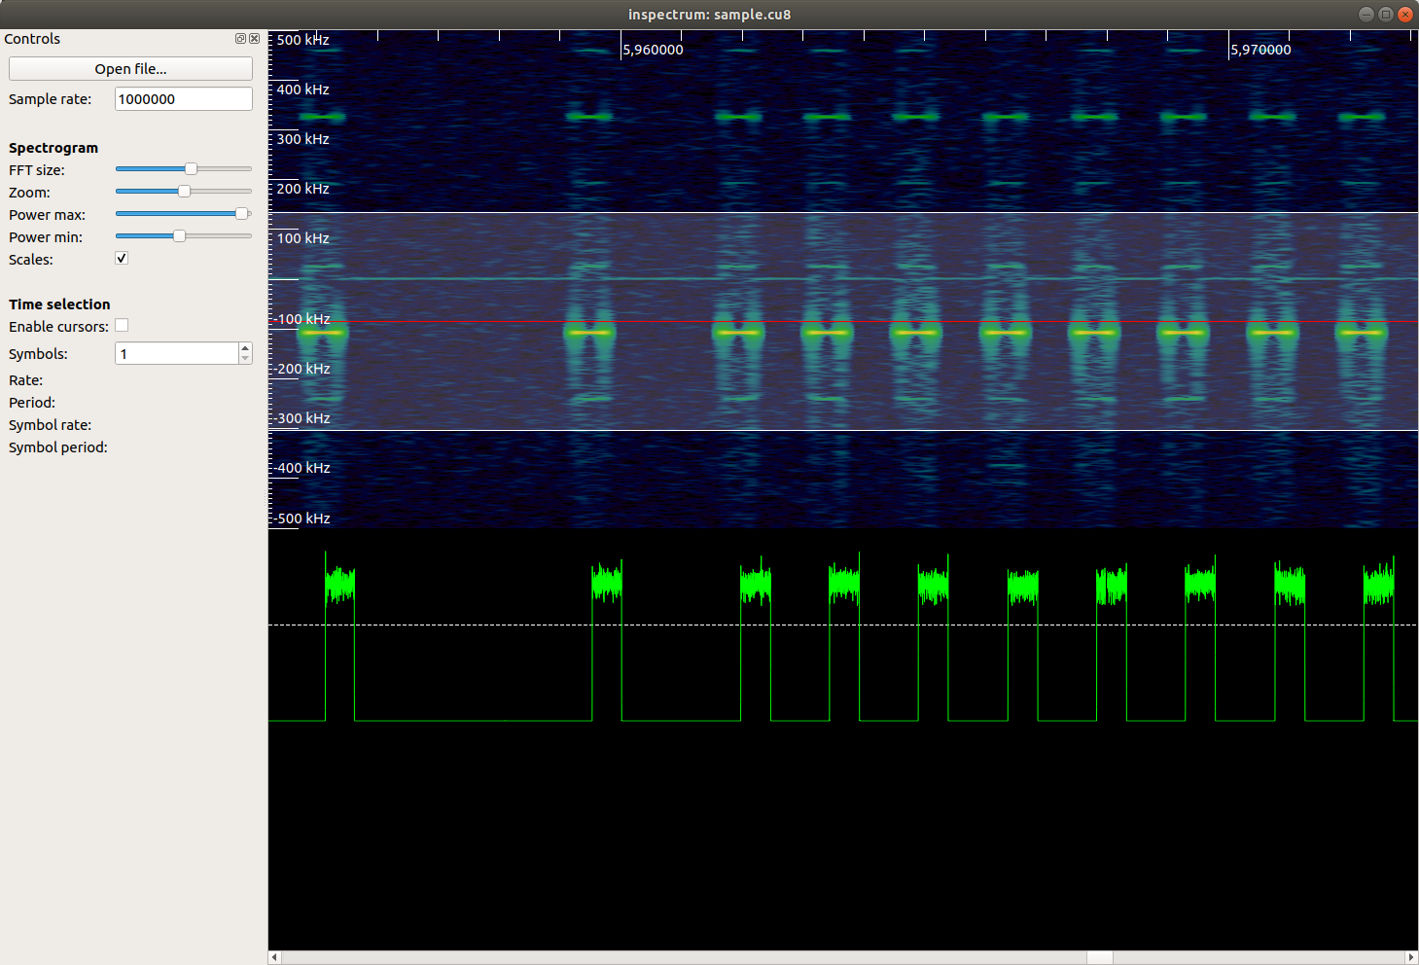
Waterfall
FFT
Magnitude
Frame Gap
(very long)
0
(long)
1
(short)
1
(short)
1
(short)

